Slide 1






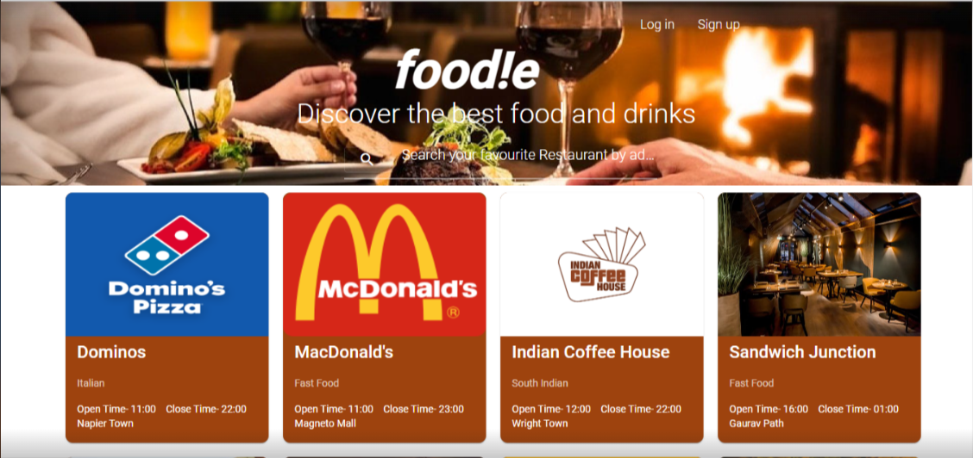


FOOD!E APP
- Adarsh Sharma
- Arpit Mukharya

Slide 2







Our Team
Arpit Mukharya
Adarsh Sharma

Slide 3






About Foodie App
Online food ordering system provides all the restaurants details and allows user to order more than one item at the same time and also enjoy the coupons.
This platform will allow user to provide users review and ratings for various restaurants so accordingly one can conclude by looking at it.

Slide 4





Benefits of Foodie App
1. User can signup and receive credentials via e-mail & login.
2.Vendor can signup and receive credentials via e-mail & login.
3.User can order food online,add favorites,give reviews.
4. User can search restaurants by address.
5. User can apply coupons.

Slide 5






Functionalities
1.User can update their profile .
2.User can set their profile picture,add multiple address .
3.User can categorize menu items based on its category.
4.Vendor can list his/her restaurants in the application & monitor orders of particular restaurants.
5.Vendor can update their restaurant picture also menu list items in the application.
6. Admin can monitor all users registered along with their role, all restaurants listed , all orders received and all reviews posted.

Slide 6
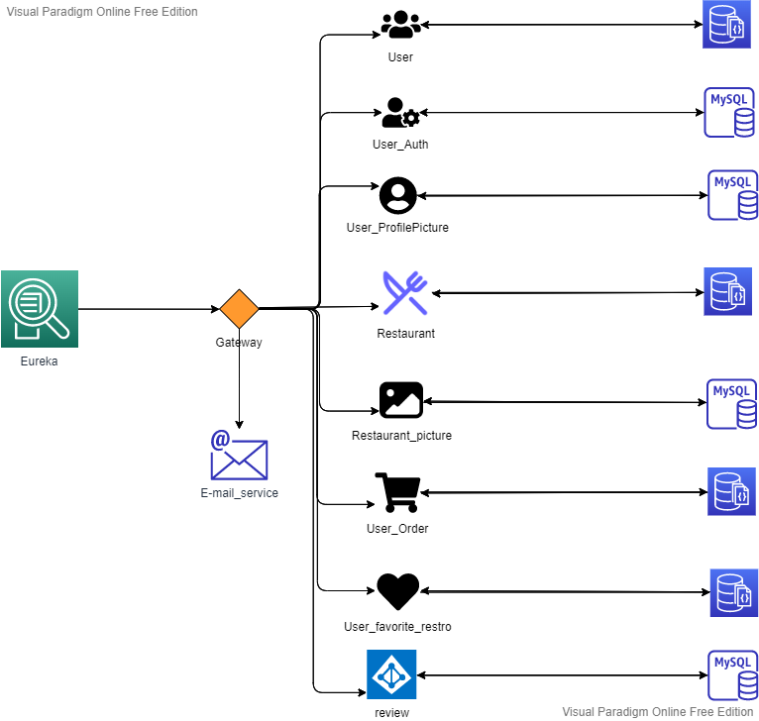
MicroService-Architecture Diagram

Slide 7

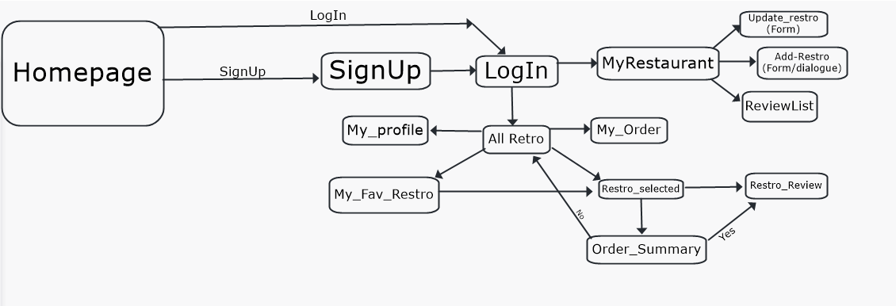
Front-end Flow-Diagram
vendor
User

Slide 8
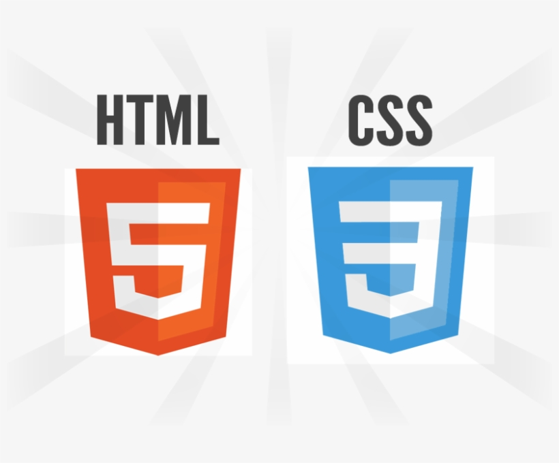




Technologies Used
DataBase Used

Slide 9
Tools Used
Eureka
API-Gateway
Hystrix
Rabbit MQ
Feign Client
Docker

Slide 10




Landing Page

Slide 11
Q&A

Slide 12
Future Enhancememt
1.Live location & order tracking can be added.
2.Payment gateway can be introduced.
3.User can customize their food order.
4.Show only active order to restaurant vendor.
5.Send an order ready notification to customer.

Slide 13

Thank You

